Slide 1
Welcome To My IEP Meeting
By: Eric Johnson

Slide 2
Welcome
Welcome to my meeting. Today we are going to plan my program for the next year.

Slide 3
Introductions
Eric Johnson
I am a student at Olympia High School
I am 17 years old.
I will graduate on 2013 or 2012 (hopefully.)
Please introduce yourselves.

Slide 4
Review of the School Year
Things that have worked well for me this year are:
I enjoy ASAG.
I learned how to say phenomenon.
I have better handwriting.
Will work for food.

Slide 5
Review of the School Year
Things that haven’t worked very well for me are:
82 minute classes

Slide 6
What do others have to say?
Does anyone want to comment on how I am doing?
Mother and father
Ms. Kirby
Guidance counselor
Mrs. Ringer

Slide 7
When I finish high school, I want to…
Work: Barge deck hand.
Education: do not wish to go to college.
Training: apprenticeship for barge work.
Living arrangements: rent a house.

Slide 8
Goals for the year
Mrs. Ringer, will you please share my goals with everyone?

Slide 9
This year in school I want to….
Pass all my classes.
Get along with all of my teachers.
Not get into trouble.
Get organized.

Slide 10
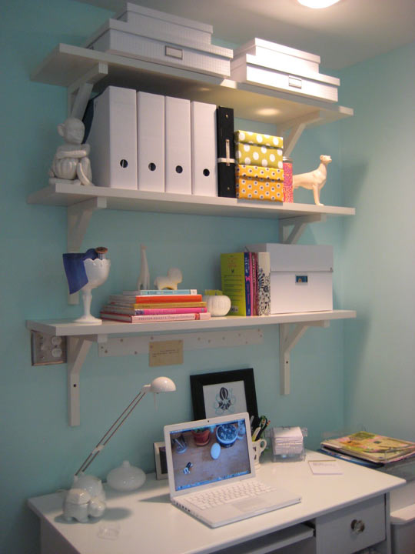
For me to be successful in school this year, I need…..
Organization
Preparation
Commitment
food

Slide 11
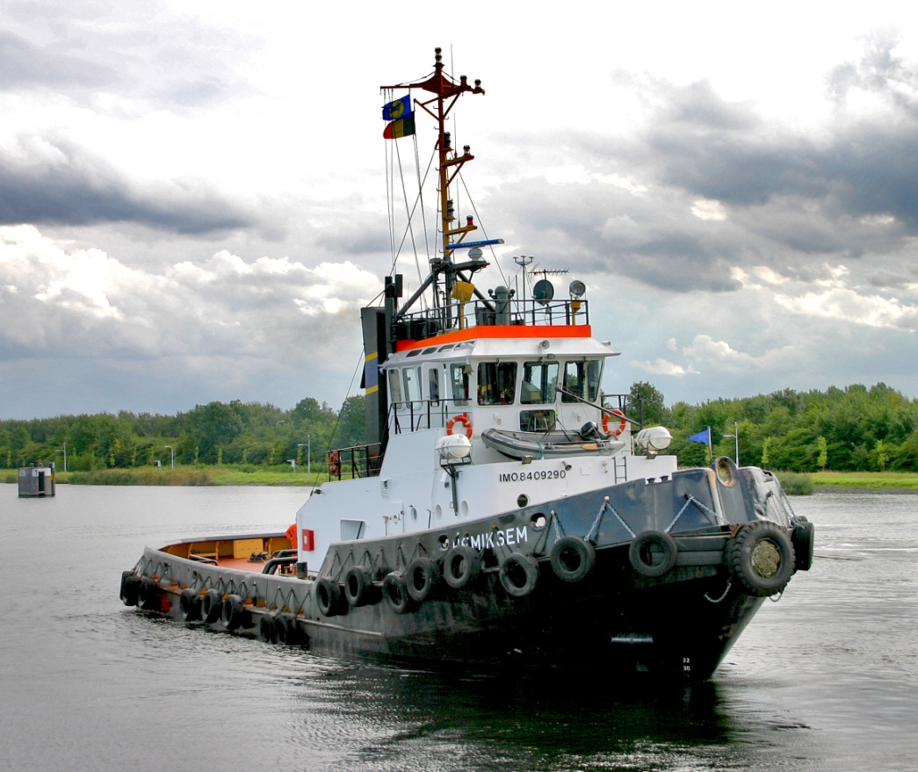
Summary of my goals
In summary, my future plans are to work on a barge for ADM. I want to rent a house or apartment and be independent.

Slide 12
Summary of goals
For me to make progress toward these goals, I will do these things this year:
I will pay closer attention during class.
I will not fight with my bus driver.
I will try to take my homework home.
I will come to class prepared.
I will organize my locker.

Slide 13
Review my support needs
The things that need to be in my program to help me succeed are:
Extended time (as needed)
Alternate setting (as needed)

Slide 14
It’s time for Mrs. Ringer to talk
Does anyone have anything they want to say about my program?

Slide 15
Conclusion

