Slide 1
Welcome to my IEP
Nick Street

Slide 2
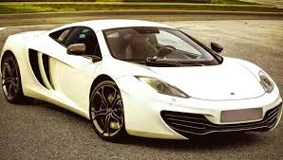
Welcome
Welcome to my meeting. Today we are going to plan my program for the next year.
Thank you for coming to my meeting. Today we are going to plan my program for the next year.

Slide 3
Introductions
My name is Nick
I am a student at Olympia Middle School
I am 13 years old.
I will graduate on 2018
Please introduce yourselves.

Slide 4
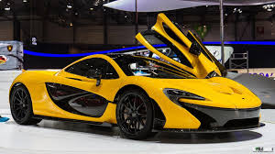
Review of the School Year
Things that have worked well for me this year are:
Small groups
partners
listening to music when working
When tapping my pencil on the desk

Slide 5
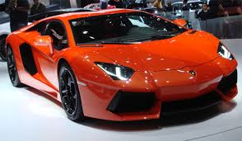
Review of the School Year
Things that haven’t worked very well for me are:
Sitting next to loud people
people detracting me

Slide 6
What do others have to say?
Does anyone want to comment on how I am doing?
Parents
Mrs. Ross
Miss Ringer
Others

Slide 7
When I finish high school, I want to…..
Work: McDonalds
Education: ILL University (2 year college)
Living arrangements: in a dorm with my cousin.

Slide 8
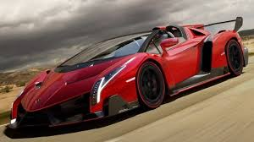
Goals for the year
Miss Ringer, will you please share my goals for this year with everyone?
Mr. Neylon, will you please share my goals for next year with everyone

Slide 9
This year in school I want to….
Try to get all A’s.
Make all the teachers happy
I want to go to high school.

Slide 10
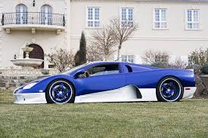
For me to be successful in school this year, I need…..
I need to learn how to write out an application for a job.
I really need to work on my social study's.

Slide 11
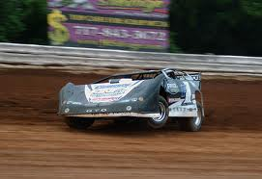
Summary of goals
For me to make progress toward these goals, I will do these things this year:
Have a bag of fruit loops.
Make all the teachers happy.

Slide 12
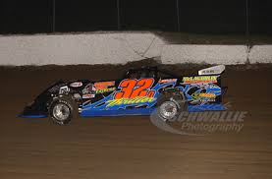
It’s time for Miss Ringer to talk
Does anyone have anything they want to say about my program?

Slide 13
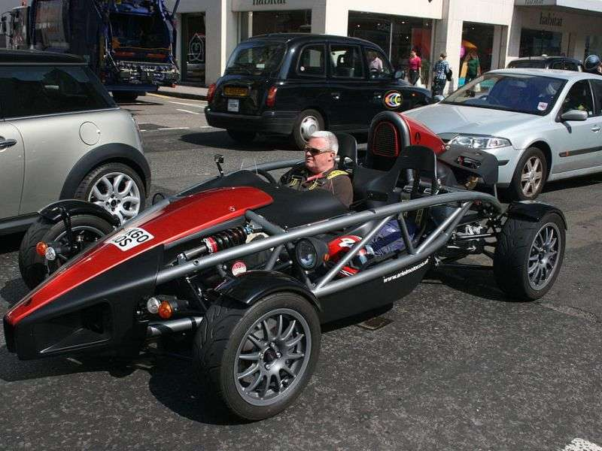
Conclusion
Thank you all for coming to my meeting.
This year I am going to work hard to achieve my goals.
I appreciate your help.

